Slide 1



CRISPResso2
Khalid Akram
3rd year Ph.D Biotechnology,
Genome Engineering Laboratory, University of Westminster, London.

Slide 2
What is CRISPResso2?
What questions can it answer?
CRISPresso2 is a software tool used for analyzing CRISPR/Cas9 (and other types of CRISPR) genome editing experiments.
Provides an integrated platform for quantifying the efficiency and outcomes of CRISPR-based modifications in genomic DNA.
Helps researchers evaluate the extent of gene editing by analysing sequencing data, particularly focusing on indel (insertions and deletions) frequencies and types.
Useful for assessing the accuracy and effectiveness of CRISPR experiments.
Q1. Did my CRISPR experiment work?
Q2. What was the efficiency of the edit?
Q3. What kind of edits were made across the cell population? (insertions / deletions / mutations).

Slide 3

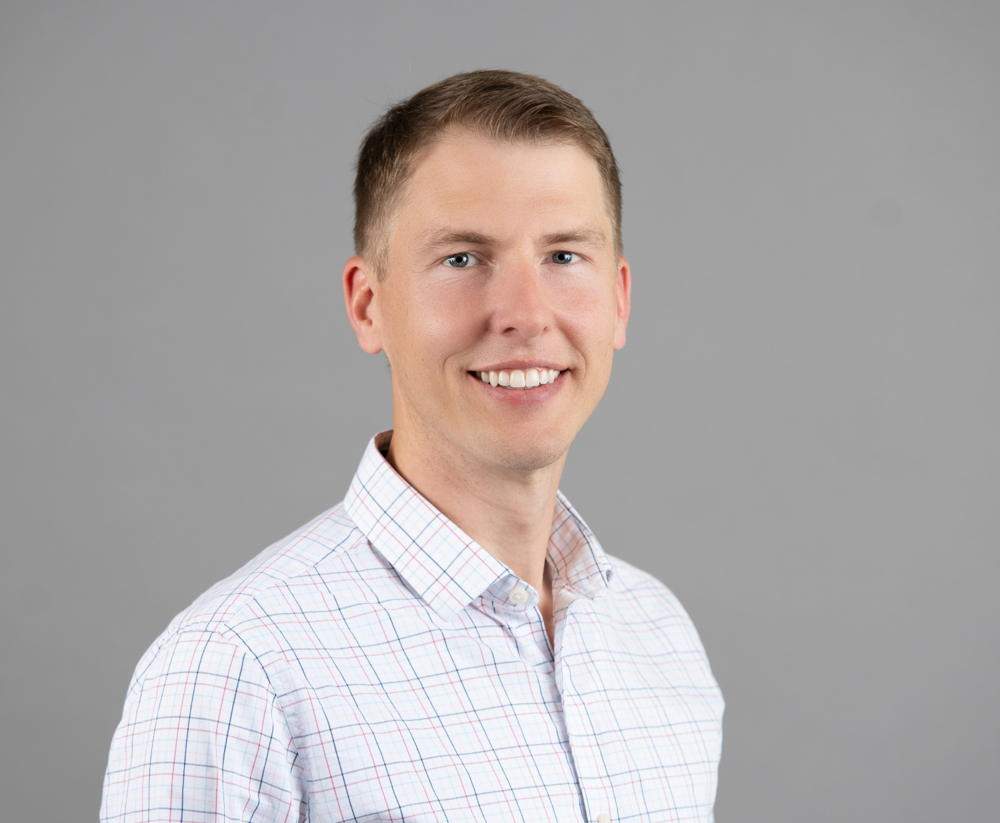
Developers of CRISPResso2
Luca Pinello
Ph.D., Associate Professor
Massachusetts General Hospital and HMS
(CRISPResso)
Kendell Clement
Assistant Professor,
Biomedical Informatics
University of Utah,
(CRISPResso2)

Slide 4
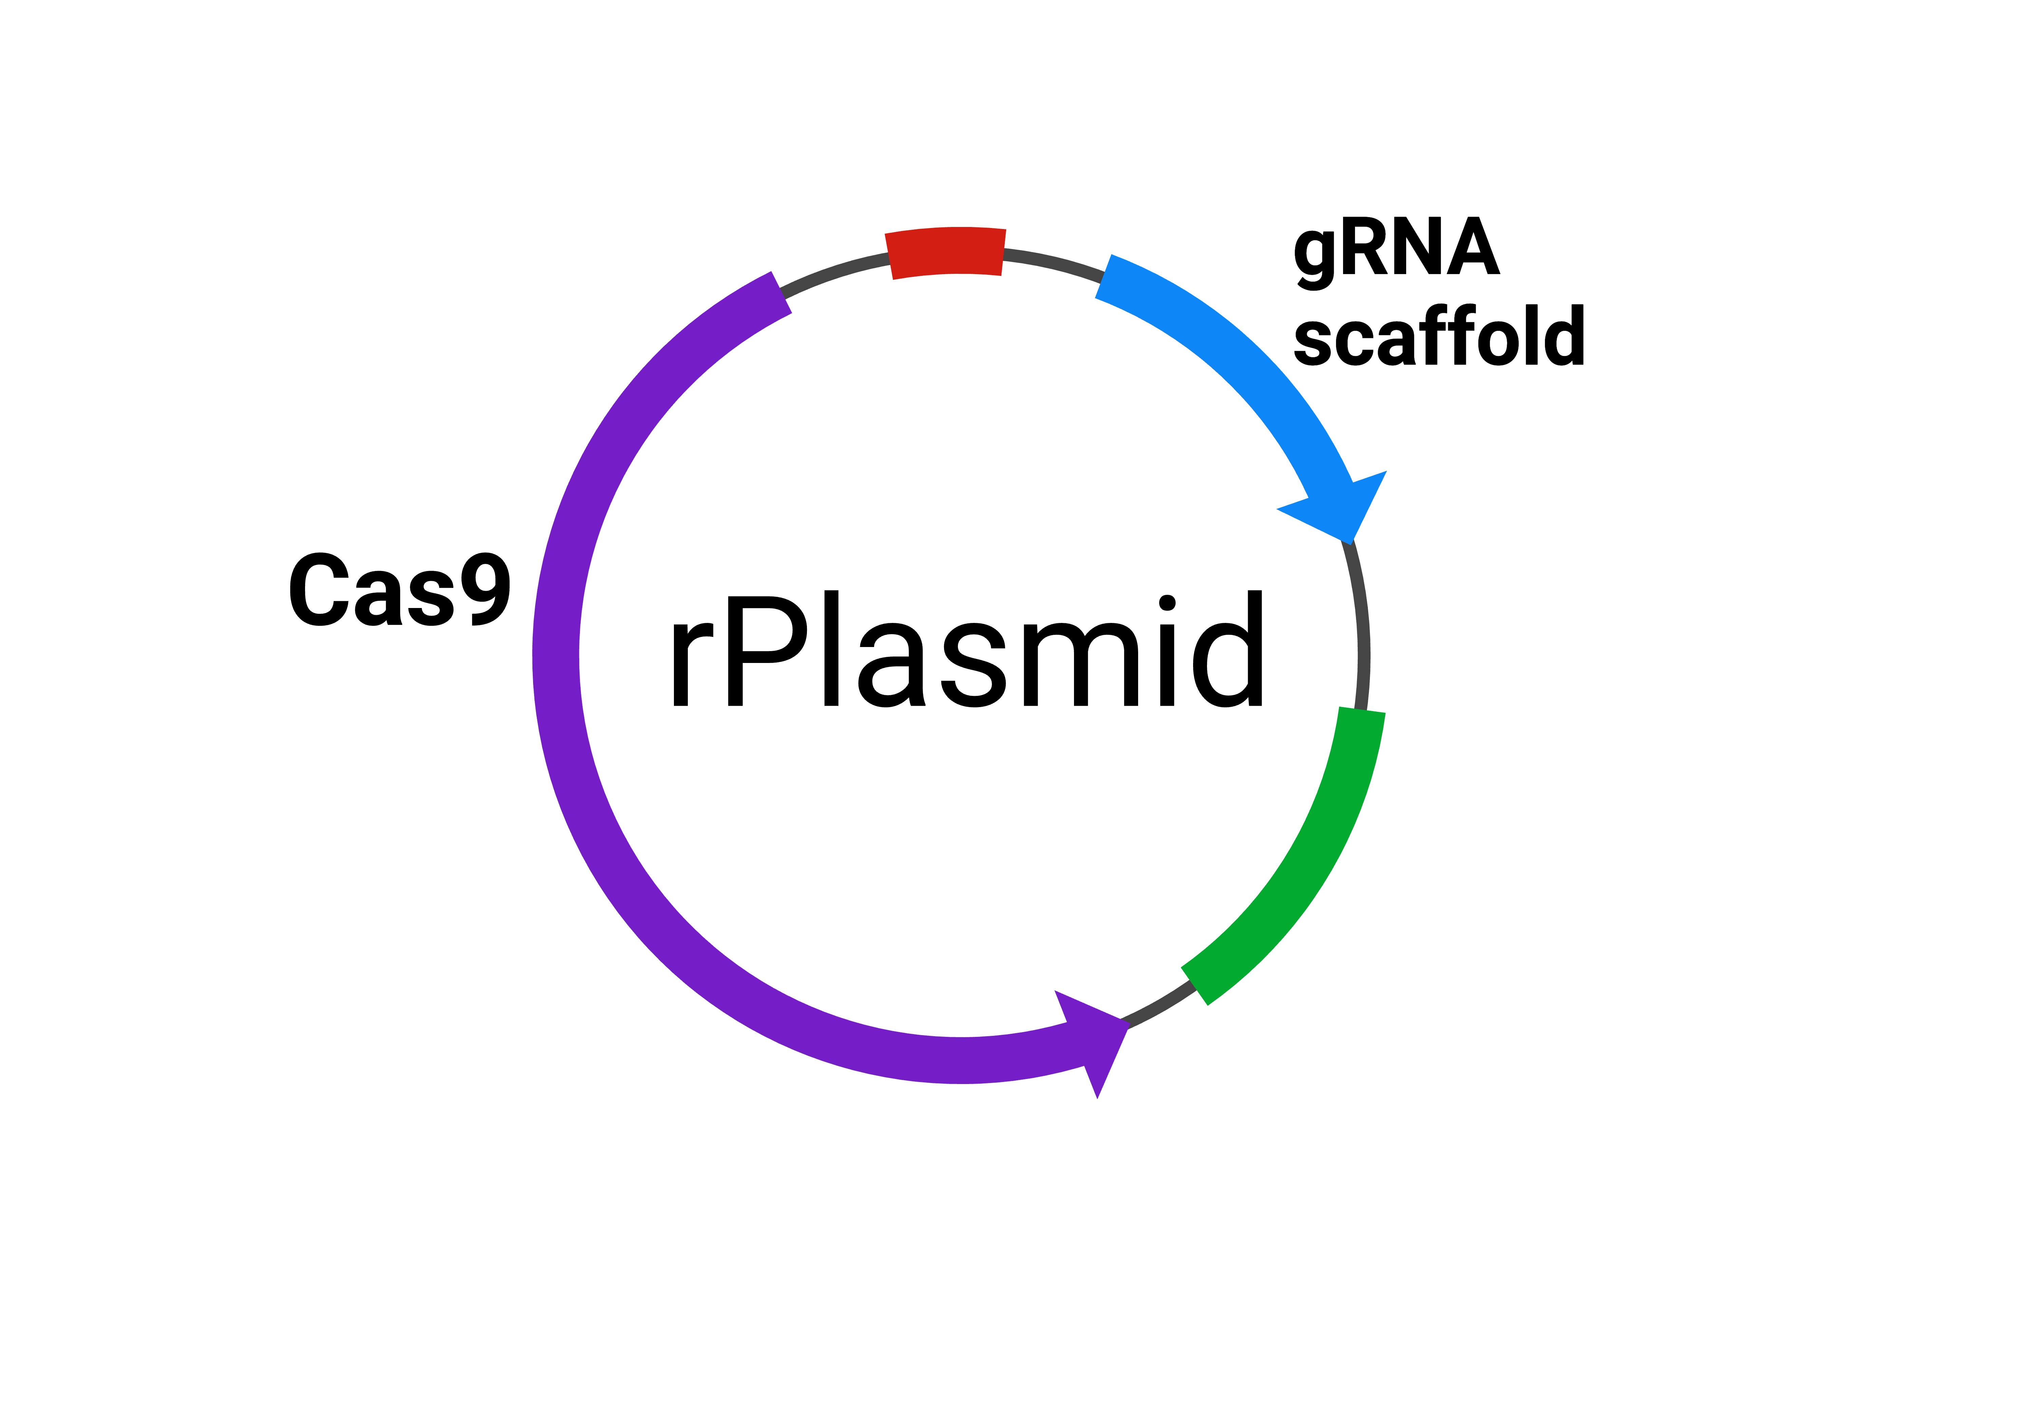
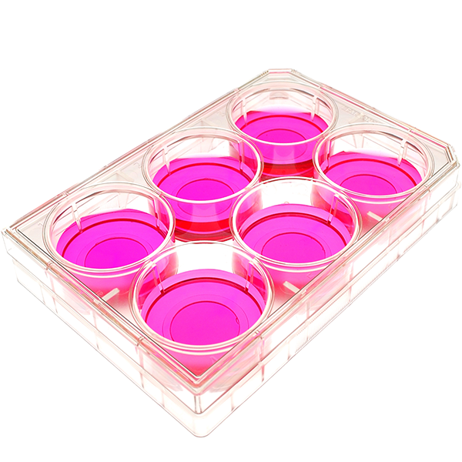
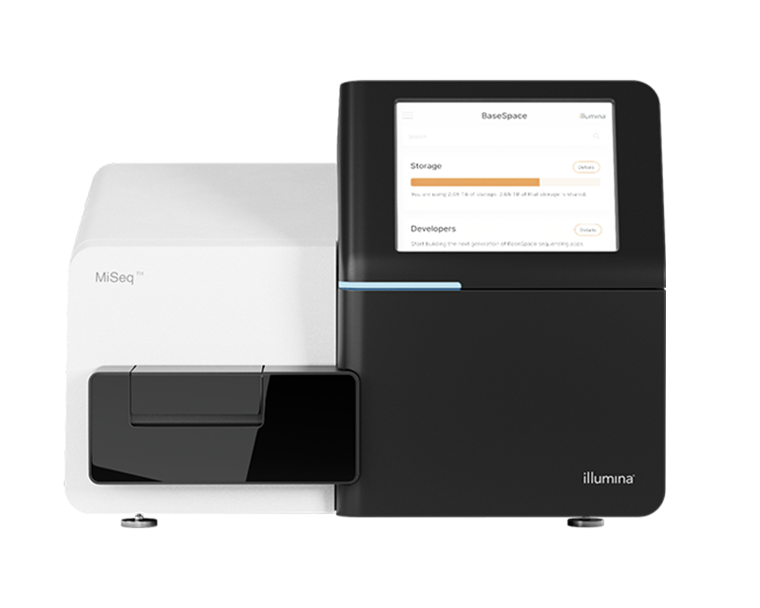
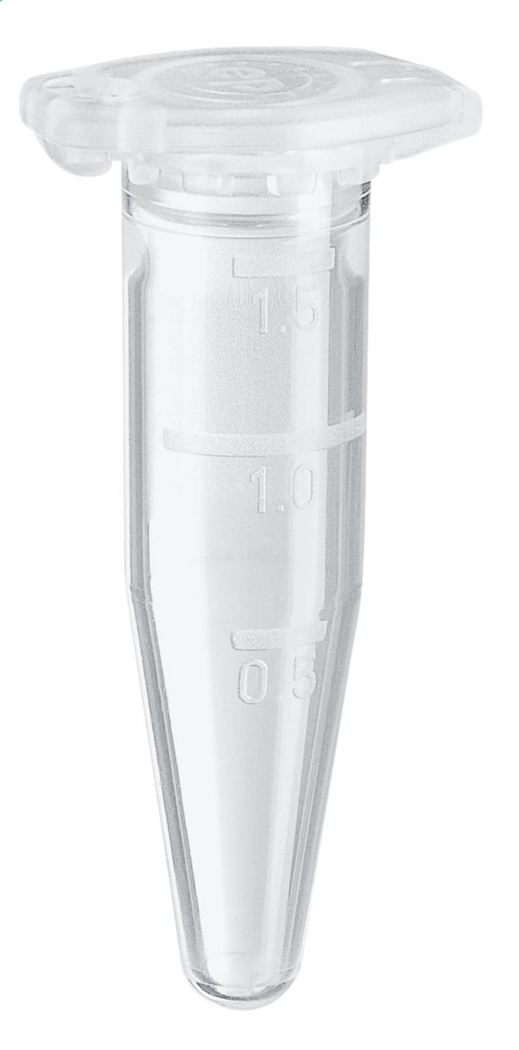

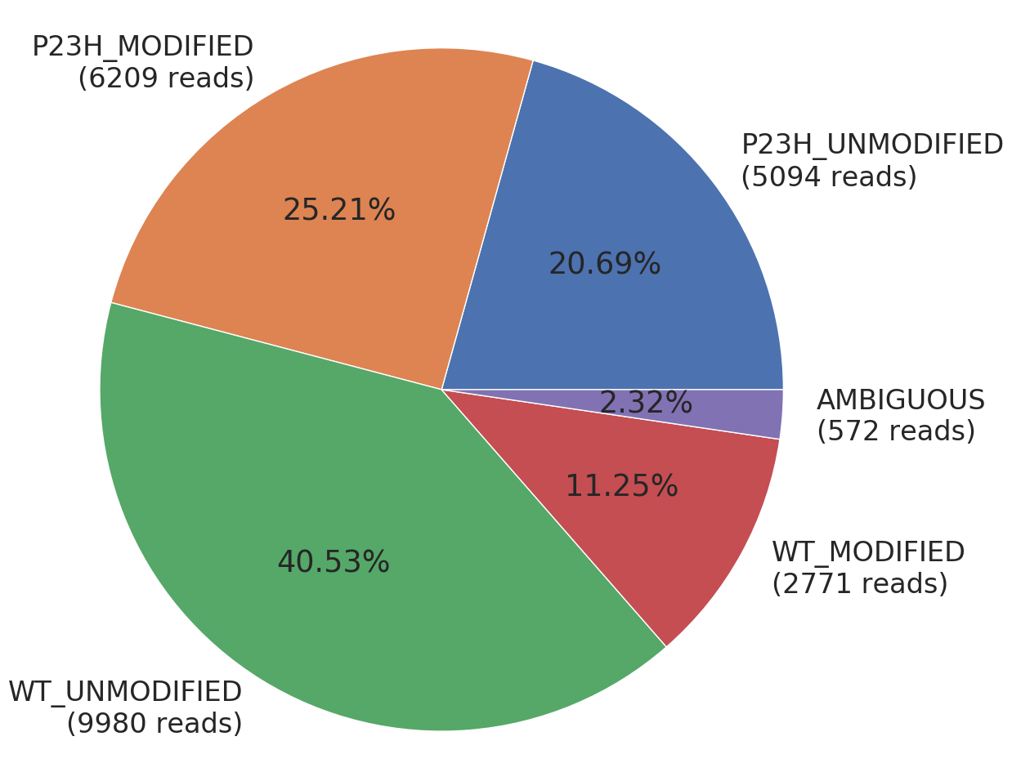
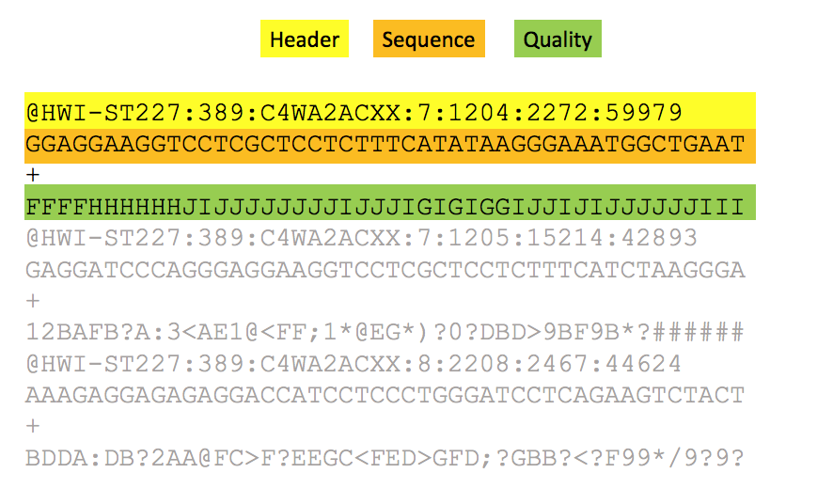
Where does CRISPResso2 fit into the CRISPR workflow?
1. CRISPR mediated transfection
2. DNA Extraction
3. Sequencing (e.g. Ampliseq)
6. Reports & Visualisation
5. Analysis using CRISPResso2
4. .fastq format files

Slide 5

Processing of .fastq files by CRISPResso2
1. Data
2. Alignment
sgRNA
ACGTACGTGAGC
Reference amplicon
ACGTACGTGAGCTGATCTGATCGATCT
Aligned sequence
ACGTACGTGAG
CTGATCGATCT
Sequencing reads (.fastq)
Quantification window
4. Summary of Editing
3. Are edits present within the quantification window?
YES
NO
Read is
modified
Read not
modified

Slide 6
Inputs to CRISPResso2
Editing Type
Data
Cas9
Cpf1
Fastq File 1
Fastq File 2
Base editors
AATGTCCCCCAATGGGAAGTTCATCTGGCACTGCCCACAGGTGAGGAGGTCATGATCCCCTTCTGGAGCTCCCAACGGGCCGTGGTCTGGTTCATCATCTGTAAGAATGGCTTCAAGAGGCTCGGCTGTGGTT
CRISPResso2
Prime editors
Amplicon
Custom
GTGCGGAGCCACTTCGAGCAGC
sgRNA

Slide 7
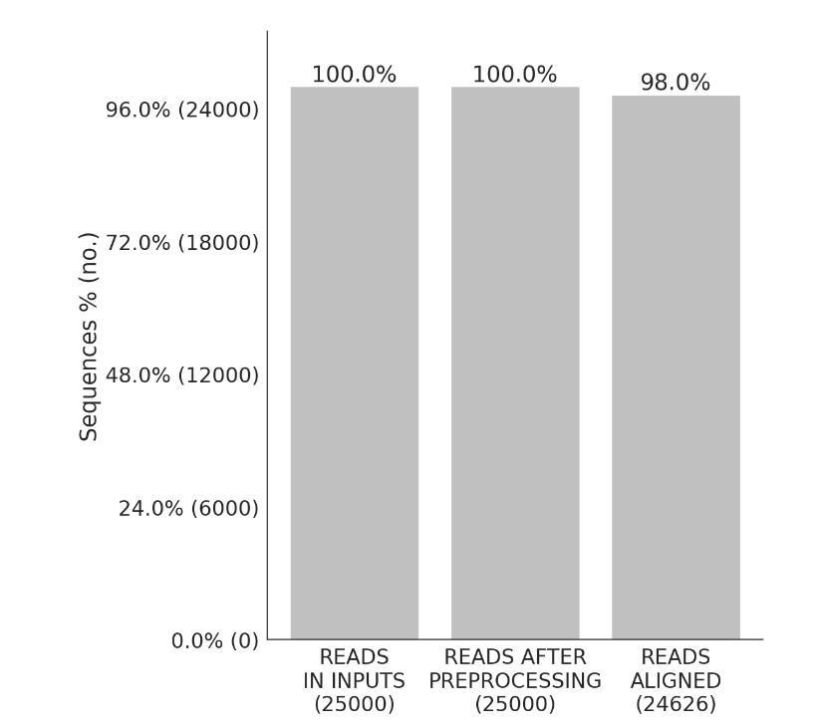
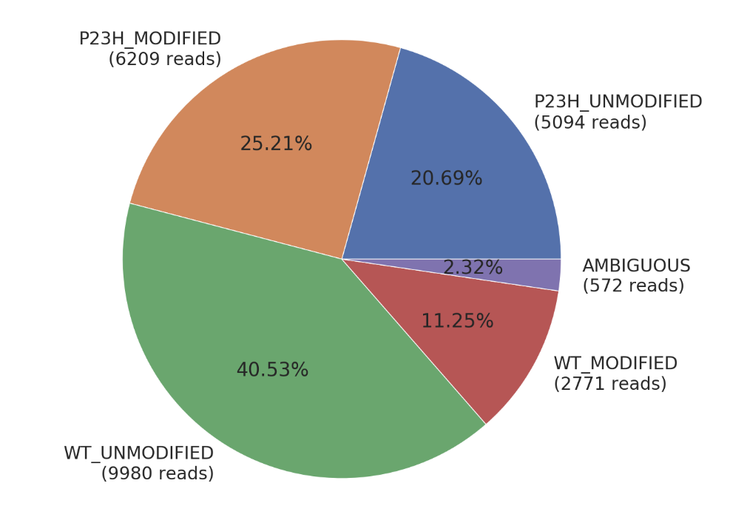
Outputs from CRISPResso2
CRISPResso2
Mapping Statistics
Quantification
of Editing

Slide 8

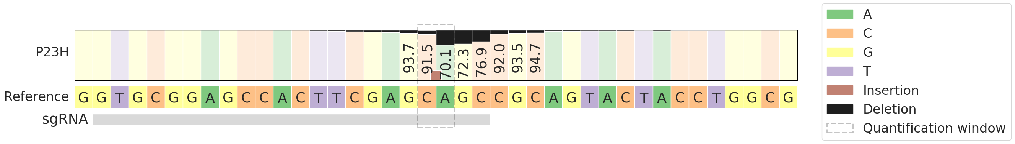
Outputs from CRISPResso2
Quantification
Window
Distribution of nucleotides in the proximity of the sgRNA and cutting site

Slide 9
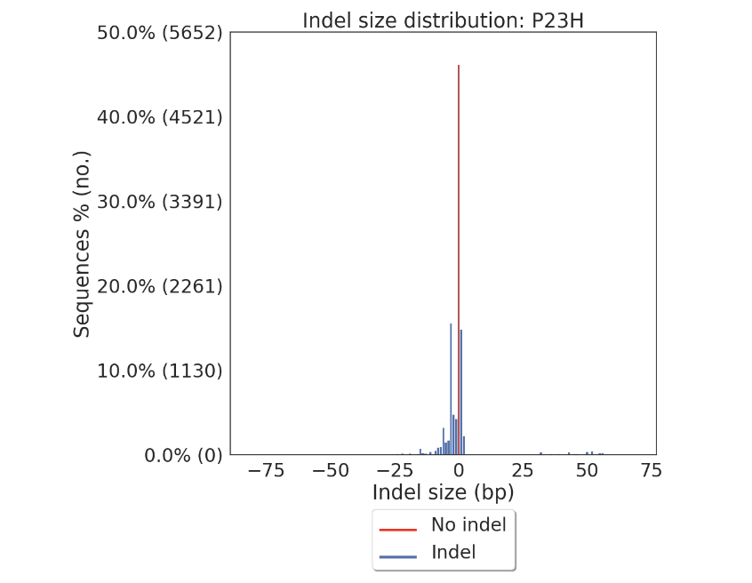
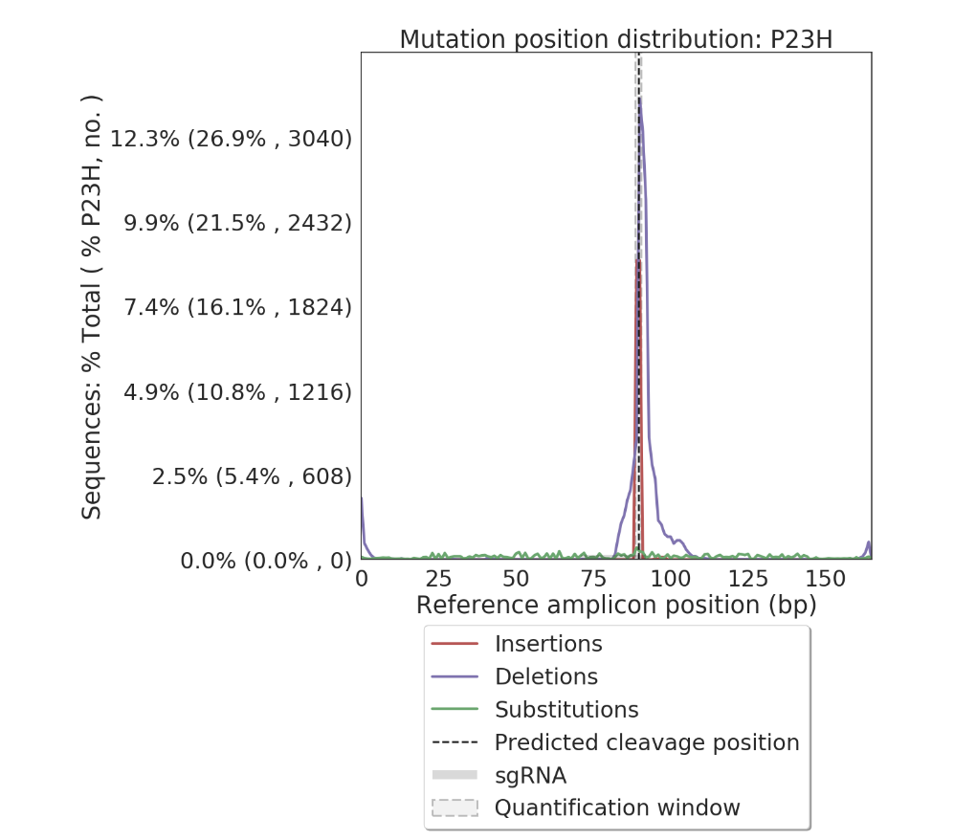
Outputs from CRISPResso2
Distribution alleles with and without indels
Frequency of insertions, deletions, and substitutions across the amplicon, including modifications outside of the quantification window.

Slide 10
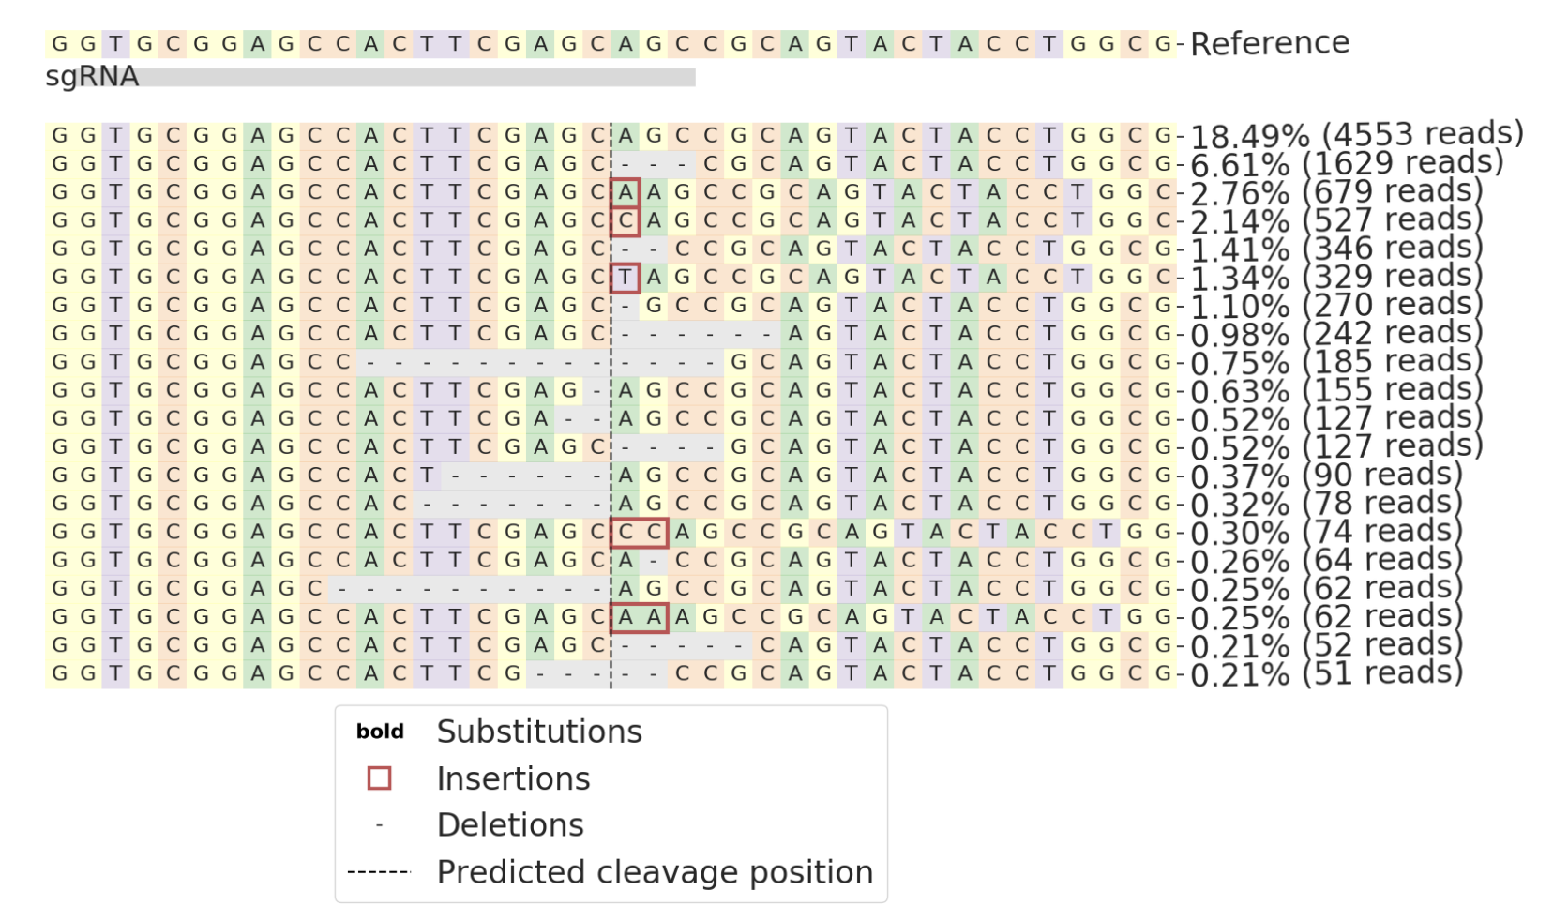
Outputs from CRISPResso2
Visualization of the distribution of identified alleles around the cleavage site for the sgRNA GTGCGGAGCCACTTCGAGCAGC. Substitutions are in bold. Red rectangles highlight inserted sequences. Horizontal dashed lines indicate deleted sequences. The vertical dashed line indicates the predicted cleavage site.

Slide 11
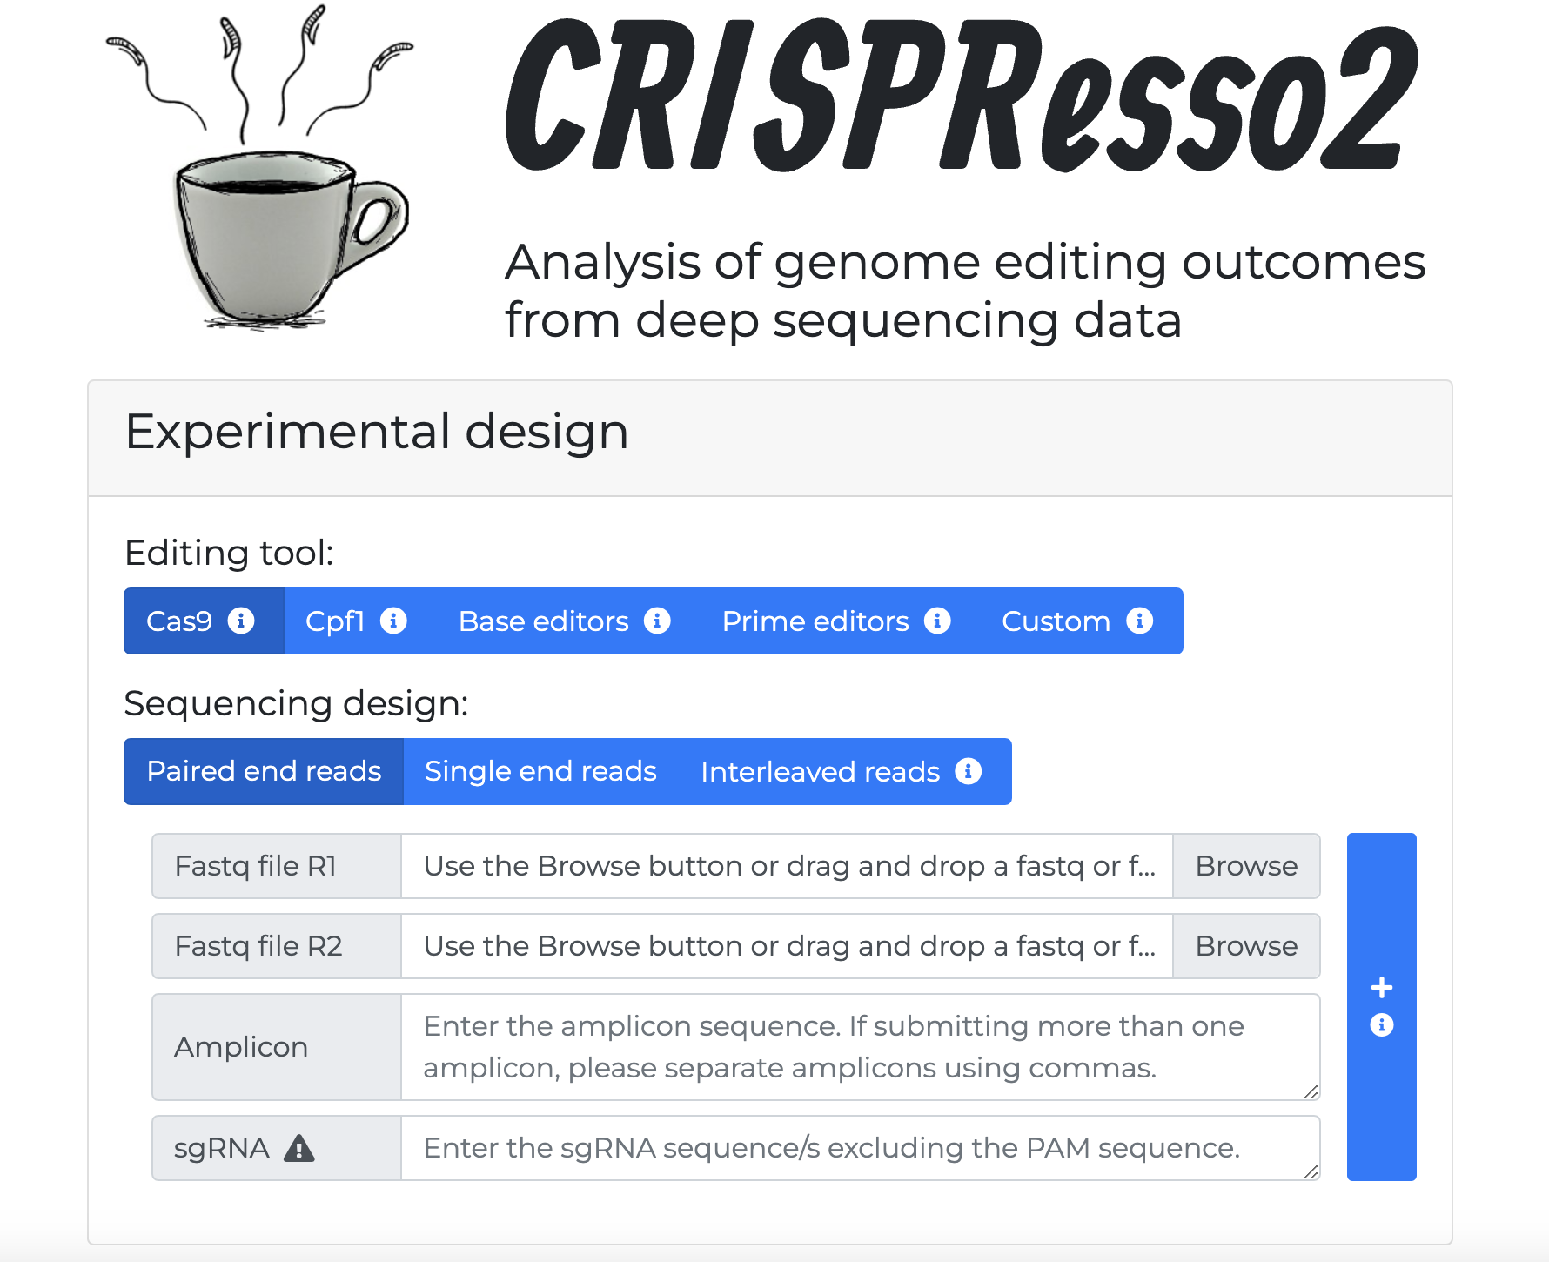
How to use CRISPResso 2 Online (Web)
http://crispresso2.pinellolab.org/
Pros:
No installation
Easy to use
Great interface
Cons:
Can’t use if offline
Slow if uploading large files
Slow if many people are using site simultaneously
URL is http rather than https – security concerns
Sometimes site is unreachable

Slide 12
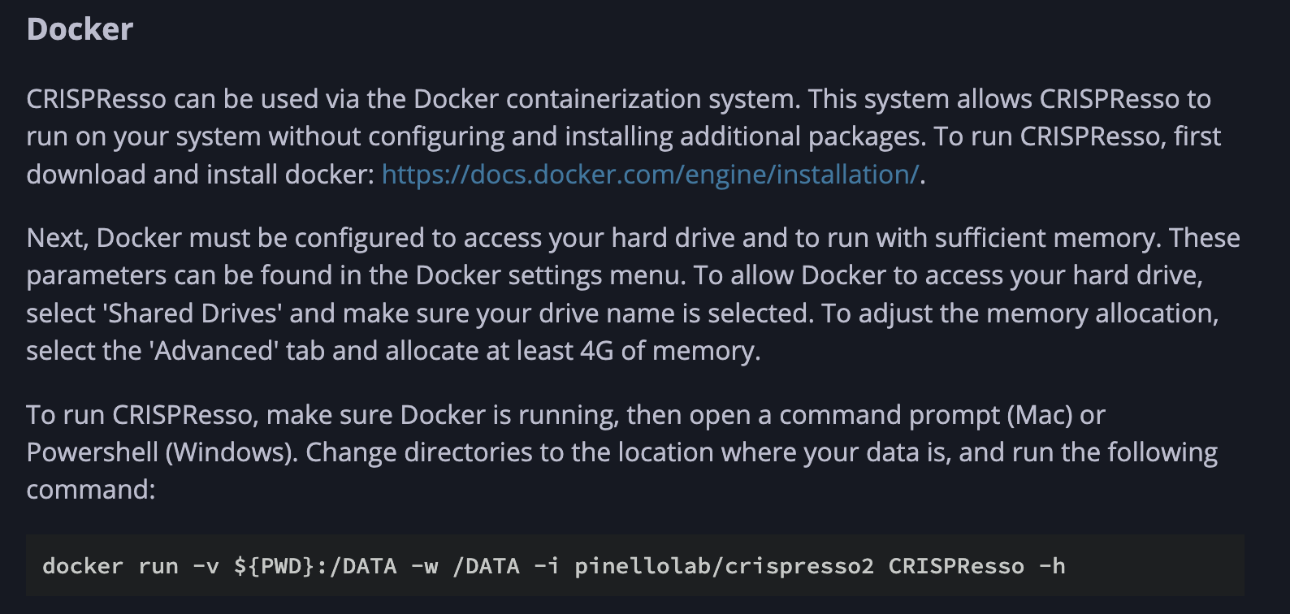
How to use CRISPResso 2 locally (on own computer)
Pros:
From official documentation:
https://docs.crispresso.com/installation.html
FAST!!
Works offline
Large files are not an issue
Docker containers make running it a breeze.
Platform independent
CRISPResso can be installed using the conda package manager Bioconda, or it can be run using the Docker containerization system.
Running via docker is probably the easiest way, as you don’t have to worry about which packages to install
Cons:
Need to be slightly more tech savvy
Command line interface can be daunting for some
Install Docker
Some command line knowledge required

Slide 13
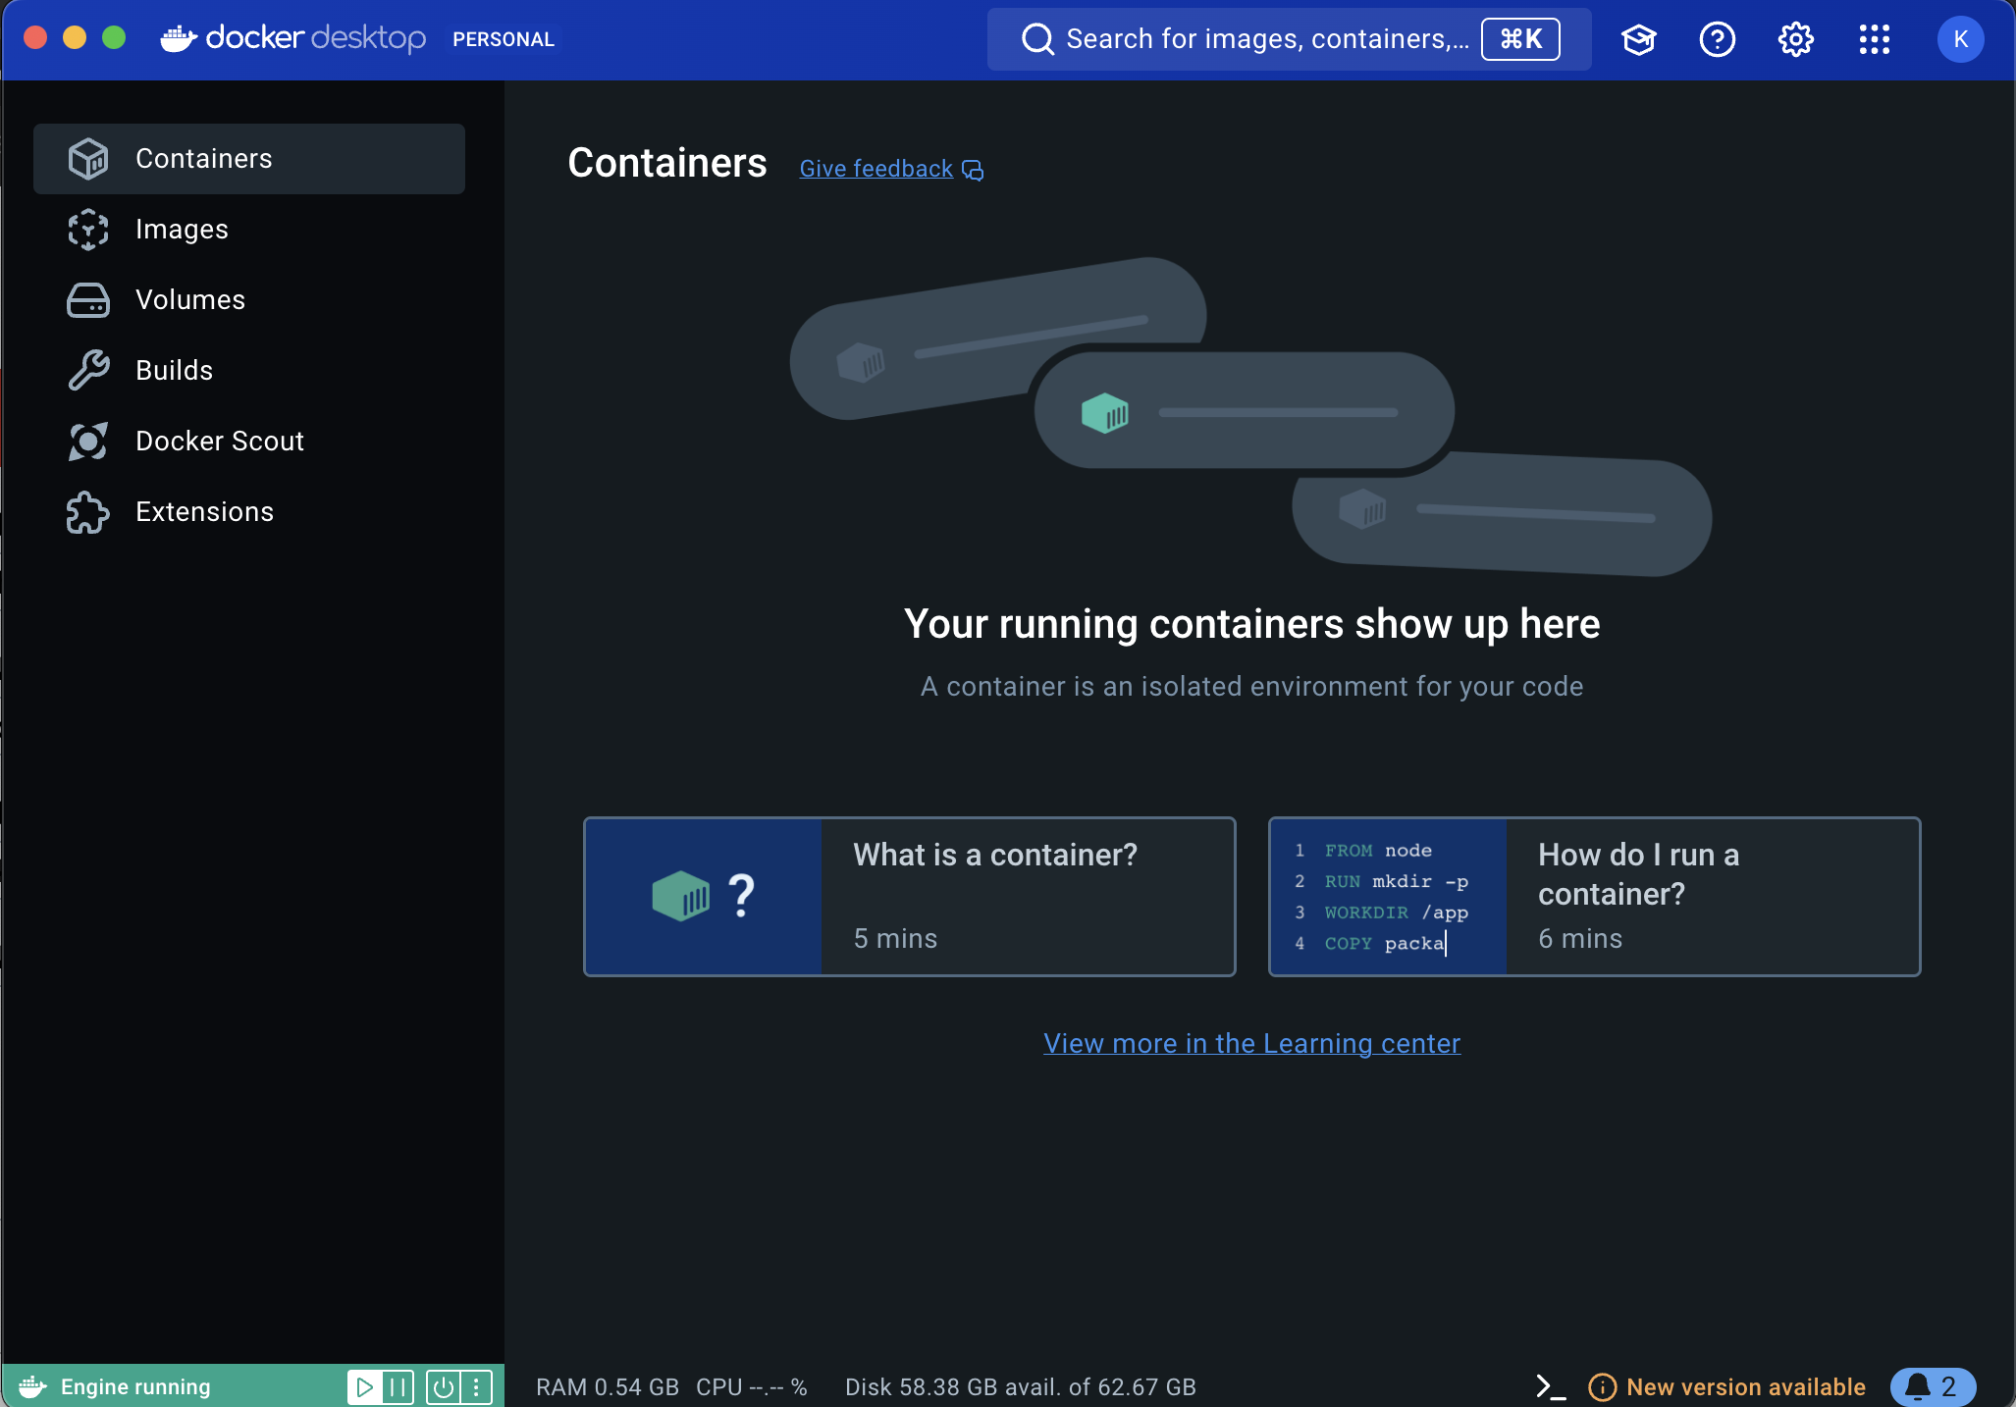
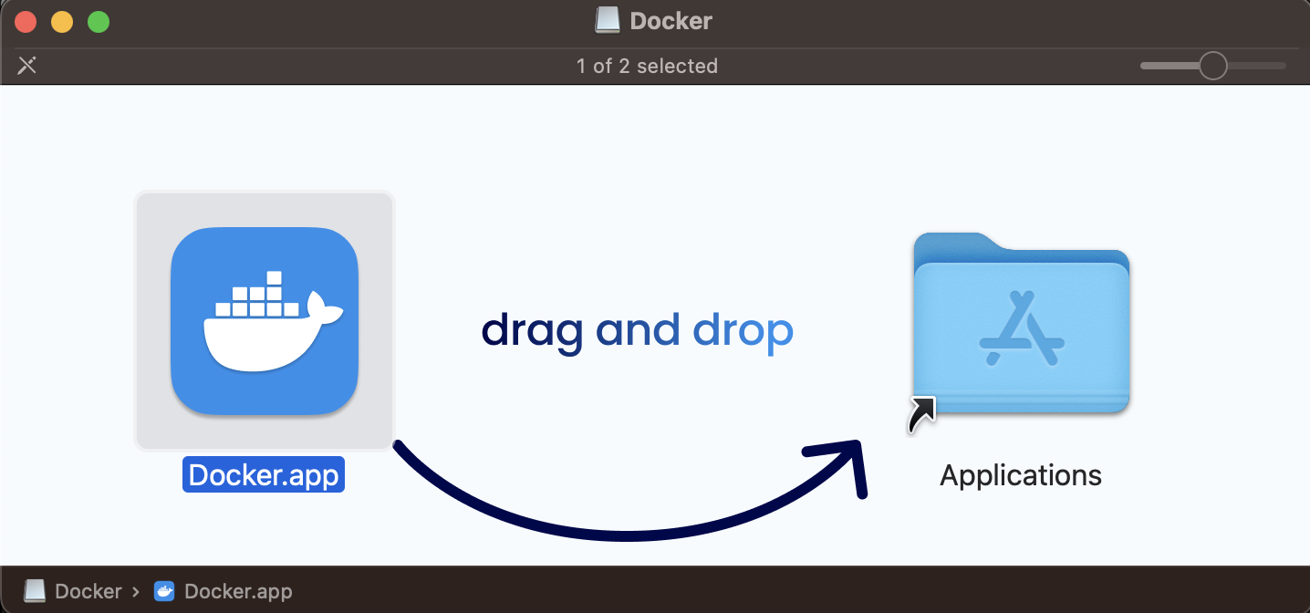
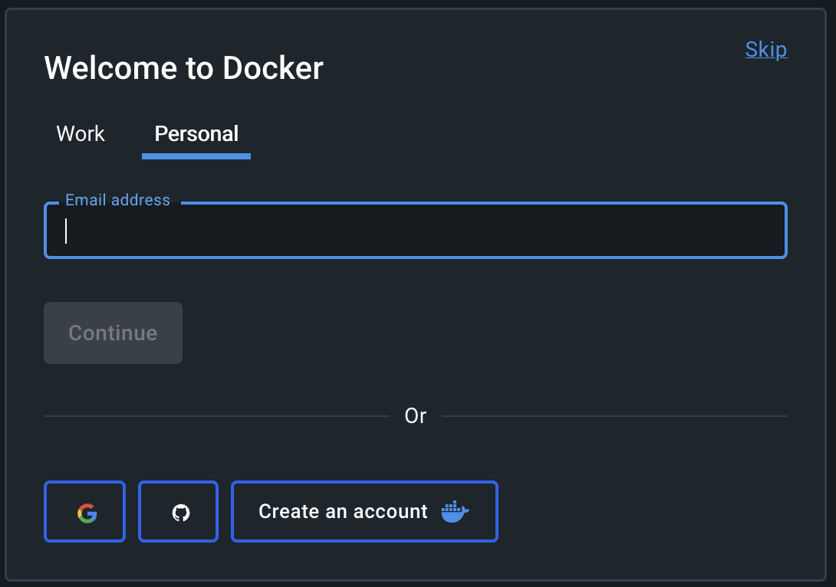
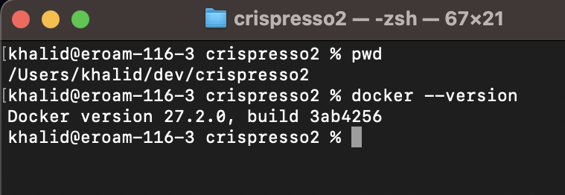
Getting Docker up and running (on Apple Mac)
https://docs.docker.com/desktop/
4. Home screen after sign up and logging in
https://docs.docker.com/desktop/install/mac-install/
1. Download the installer (Docker.dmg for Mac)
2. Double click then copy to Applications folder
5. Check Docker is running and version via terminal using docker –-version command.
3. Login using email or create a new account

Slide 14
Run CRISPresso2 via Docker
1. Execute the following command to download latest version of Crispresso2 container
docker run -v ${PWD}:/DATA -w /DATA -i pinellolab/crispresso2 CRISPResso -h
2. Data to be processed should be copied into working directory
(e.g. /dev/crispresso2)
3. Run crispressso2 with arguments as follows
docker run -v ${PWD}:/DATA -w /DATA -i pinellolab/crispresso2 CRISPResso -r1 nhej.r1.fastq.gz -r2 nhej.r2.fastq.gz -a AATGTCCCCCAATGGGAAGTTCATCTGGCACTGCCCACAGGTGAGGAGGTCATGATCCCCTTCTGGAGCTCCCAACGGGCCGTGGTCTGGTTCATCATCTGTAAGAATGGCTTCAAGAGGCTCGGCTGTGGTT
4. If executed successfully a directory and HTML file will be created as follows:
a) CRISPResso_on_nhej.r1_nhej.r2/
b) CRISPResso_on_nhej.r1_nhej.r2.html
5. Open HTML file 4(b) in browser to view reports

Slide 15
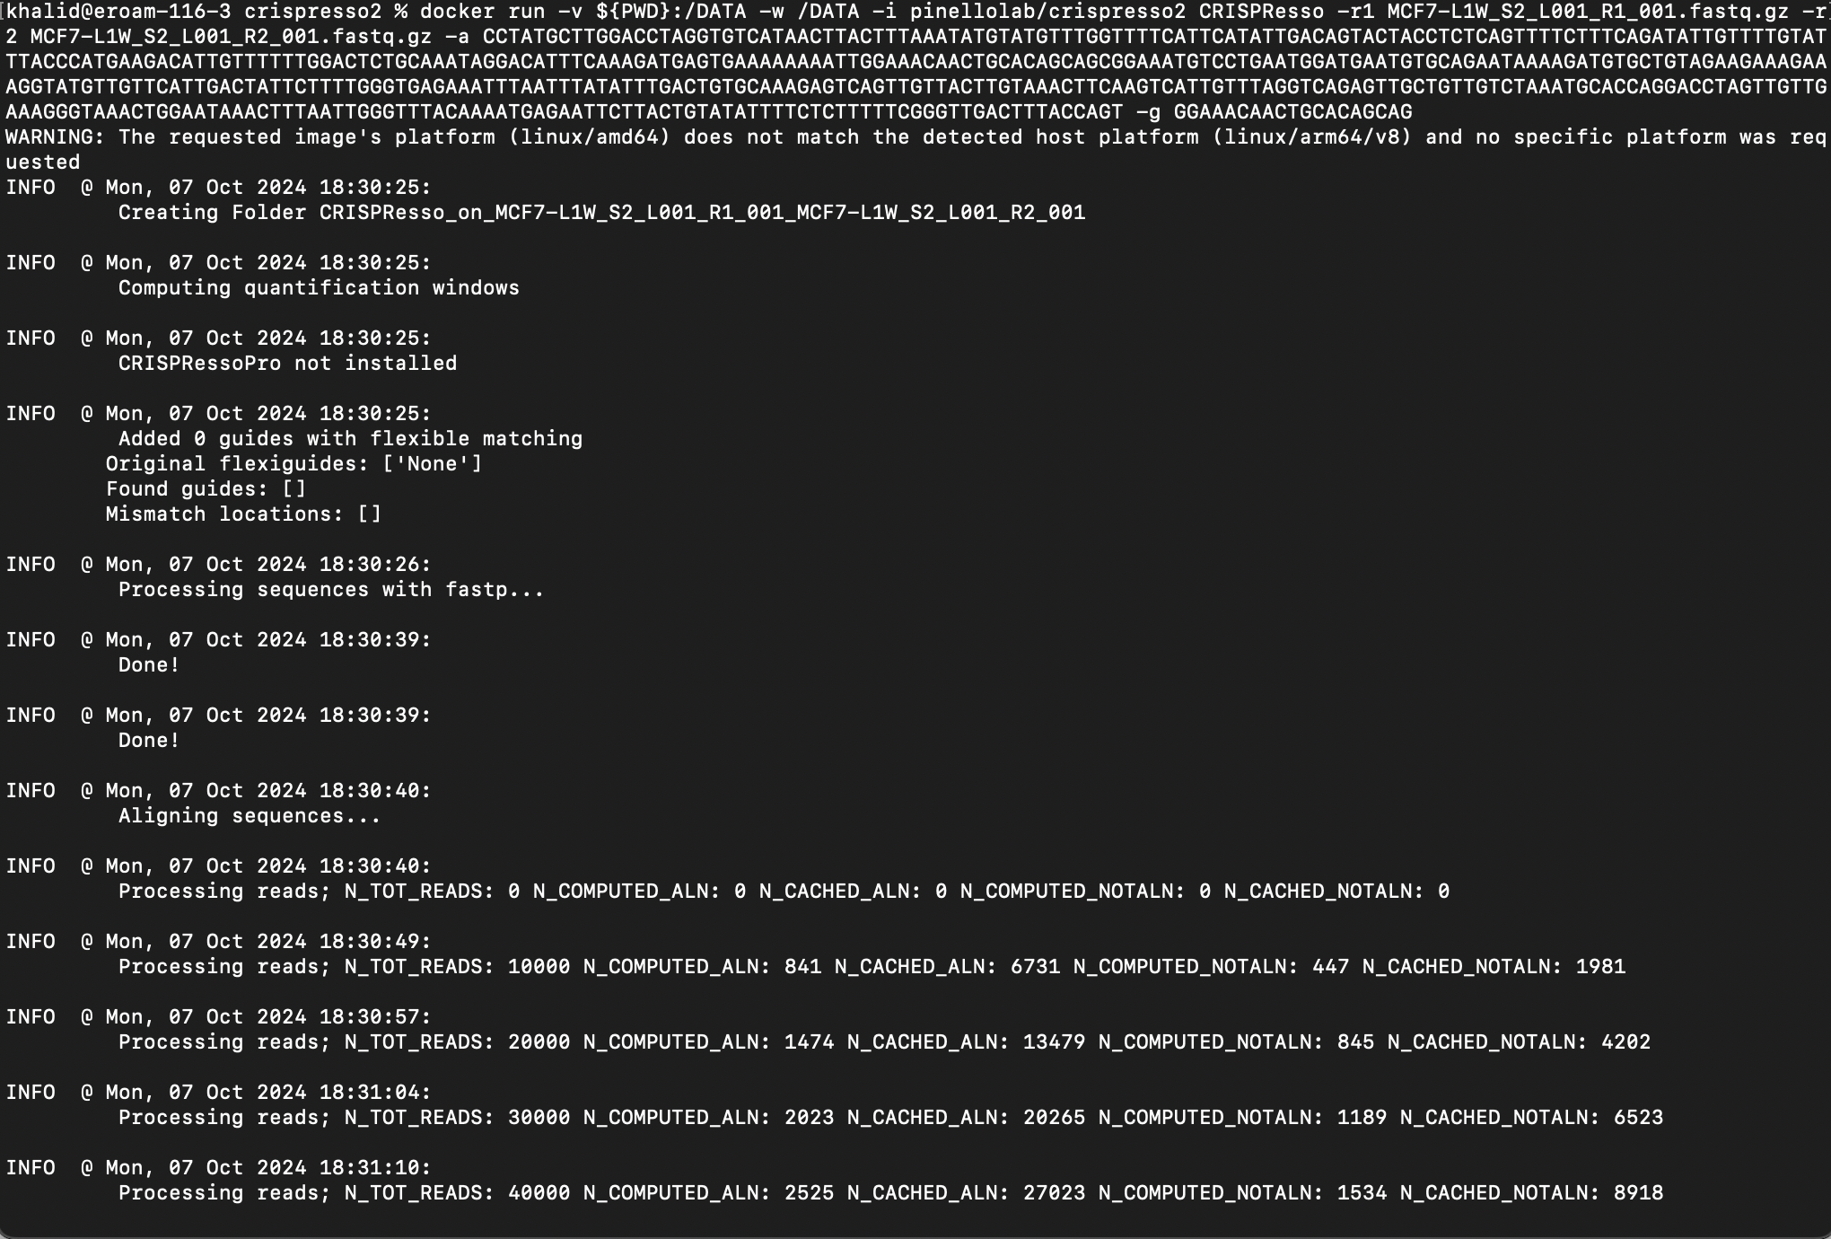
Sample output

Slide 16
Post analysis steps
Interpret allele frequencies and mutation types.
Validate your results with sequencing and functional assays.
Troubleshoot any inefficiencies (redesign sgRNA, optimize delivery).
Isolate specific clones if necessary.
Document and report your results.
Publish or share the data.

Slide 17
Acknowledgements
Developers of CRISPResso2
Funding and Support
Luca Pinello Ph.D., Associate Professor
Kendell Clement, Assistant Professor
Quentin Hogg Trust, University of Westminster
(https://quintinhoggtrust.org/)
Genome Engineering Laboratory
(University of Westminster)
Gene Editors of The Future
(University of Westminster)
Dr Kalpana Surendranath, Associate Professor, University of Westminster
Dr John Murphy, Professor, University of Westminster
Dr Munuse Savash, Ph.D, University of Oxford
Dr Varsha Tieote, Ph.D, University of Westminster
Dr Nadine Solaiman, Ph.D, University of Westminster
Dr Ahmed Sidali, Ph.D, University of Westminster
Big thank you to all the students from iterations 1-3 of this program

Slide 18

Any questions?
Contact
Email: k.akram@westminster.ac.uk
LinkedIn: https://www.linkedin.com/in/khalidakram/

